Slide 1









NASI SPONSORZY I PARTNERZY

Slide 2
DAXMD: SSAS Meets DAX and Power View
Chris Webb
chris@Crossjoin.co.uk

Slide 3
Who Am I?
Chris Webb
Email: chris@crossjoin.co.uk
Twitter @Technitrain
Analysis Services consultant and trainer: www.crossjoin.co.uk & www.technitrain.com
Co-author:
MDX Solutions
Expert Cube Development with SSAS 2008
Analysis Services 2012: The BISM Tabular Model
SQL Server MVP
Blogger: http://cwebbbi.wordpress.com

Slide 4
Who Remembers the Good Old Days?

Slide 5
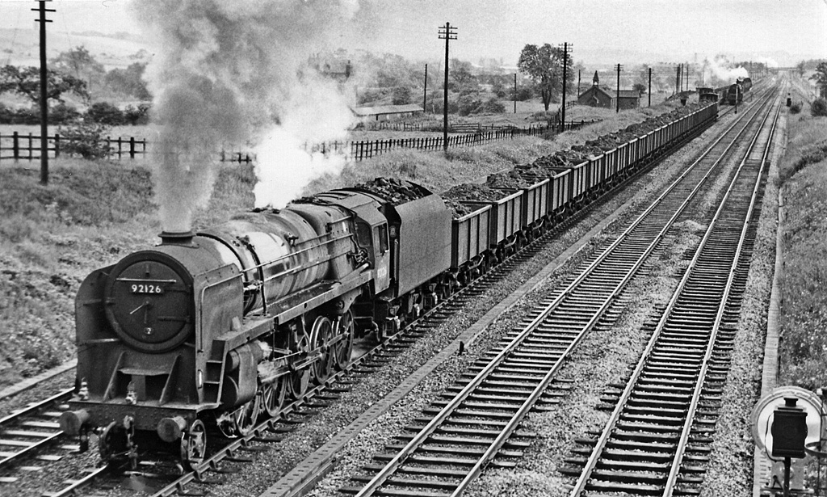
The Golden Age of SSAS Cubes!

Slide 6
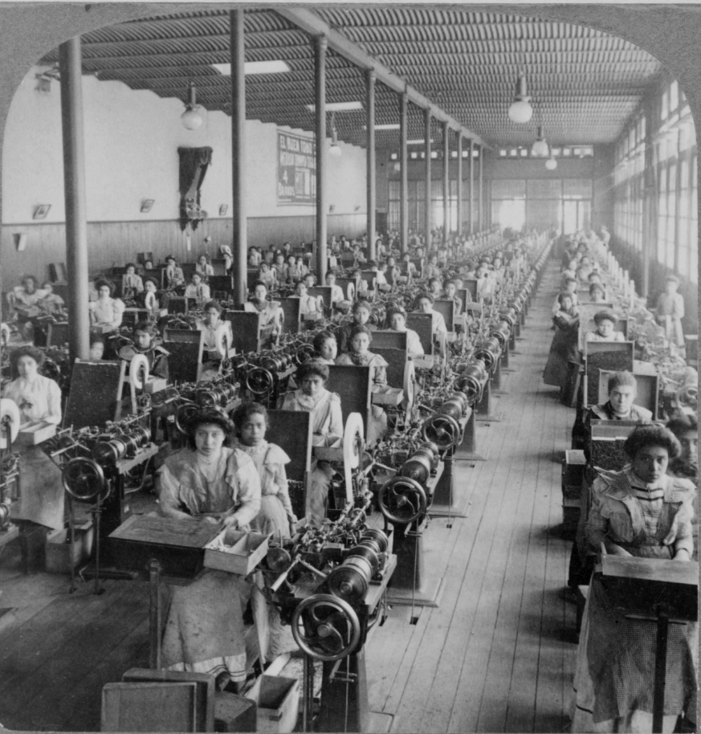
We Built Some Great BI Solutions

Slide 7
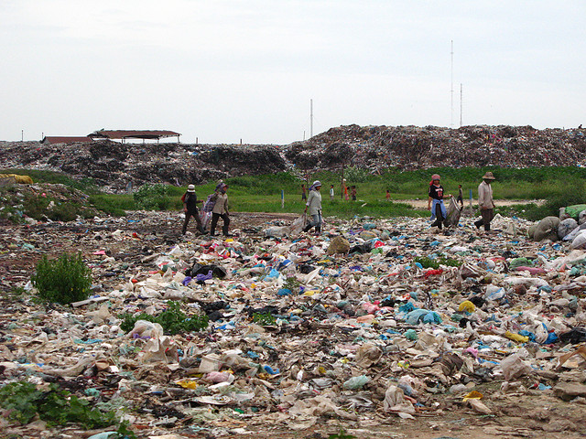
Have Those Days Gone Forever Now?

Slide 8

No, There IS A Future For SSAS Cubes!

Slide 9
Agenda
DAX on Multidimensional – What’s Changed and Why?
Multidimensional Objects and Tabular Metadata
A Guided Tour
Specific Scenarios
What Works and What Doesn’t
Writing Your Own DAX Queries
What All This Means For You

Slide 10
The Story So Far
There are two versions of Analysis Services 2012: Multidimensional and Tabular
Multidimensional only speaks MDX, Tabular speaks DAX and MDX
Excel PivotTables generate MDX queries so they work with both
Power View is Microsoft’s cool new data visualisation tool – exists as part of Sharepoint and inside Excel 2013
Power View generates DAX queries so it only works with Tabular
Therefore, today, to use Power View on SSAS you need to use Tabular

Slide 11
Analysis Services 2012
SQL Server
Other RDBMS
Text
OData
Data Sources
Multidimensional
Tabular
Analysis Services 2012
MDX
DAX
Excel / other SSAS clients
Power View in Sharepoint
Client Tools

Slide 12
Analysis Services DAXMD
SQL Server
Other RDBMS
Text
OData
Data Sources
Multidimensional
Tabular
Analysis Services 2012
MDX
DAX
Excel / other SSAS clients
Power View in Sharepoint
Client Tools

Slide 13
What’s Changed in DAXMD?
DAXMD is the codename for a new version of SSAS Multidimensional
Currently in public CTP
DAXMD supports DAX queries on SSAS Multidimensional cubes
DAX is not translated to MDX
This means Power View will work on SSAS Multidimensional cubes
Power View will have new features to support DAXMD
Will require an update to new versions of both SSAS 2012 Multidimensional and Power View in Sharepoint
Will not work with Excel 2013 Power View initially
Waiting for a service pack?

Slide 14
SSAS Multidimensional Internal Architecture
Formula Engine
MOLAP/HOLAP/ROLAP Storage Engine
MDX Query
MDX Query Support
DAX Query Support
DAX Query

Slide 15
Multidimensional – Tabular Object Mapping
Multidimensional Object | Appears in Tabular Metadata As
CUBE | MODEL
CUBE DIMENSION | TABLE
ATTRIBUTE KEYS AND NAMES | COLUMNS
MEASURE GROUP | TABLE
MEASURE | MEASURE
MEASURE WITH NO MEASURE GROUP | MEASURE IN TABLE CALLED “MEASURES”
MEASURE GROUP -> CUBE DIMENSION RELATIONSHIP | RELATIONSHIP
PERSPECTIVE | PERSPECTIVE
KPI | KPI
USER OR PARENT/CHILD HIERARCHY | HIERARCHY

Slide 16
Connecting to a DAXMD Instance
Create a new Report Data Source connection file
Choose Data Source Type “Microsoft BI Semantic Model for Power View”
In the connection string, enter:
The name of the DAXMD instance
The database name
The name of the cube you need to connect to
If using Translations, also need to add Locale Identifier property
Choose appropriate credentials
Data Source=WIN-LSBGBK95L52; Initial Catalog=DAXMDDemos; Cube=SimpleCube

Slide 17
Maps and Images
To enable Power View maps on an attribute:
Set the dimension’s Type property to Geography
Set the attribute’s Type property to a value like Geography\Country
To enable image urls in Power View:
Set the attribute’s Type property to Image\ImageURL
Images stored as BLOBs in SSAS are not supported

Slide 18
Parent/Child Hierarchies
Parent/Child Hierarchies are supported
But in Power View they appear as flattened tables with repeating values
You can only show one level’s values at a time

Slide 19
Default Members
Default Members are supported
Become automatically applied filters in the filter pane – easy to override if you need to
Also apply filters to related attributes
Eg set a default member on City and Country gets filtered too

Slide 20
Measures and Format Strings
Measures in Multidimensional return variants, and Power View now supports this
Power View supports some, but not all, format strings
Not supported:
4th section of format string for null values
Some formats that return strings
Some date formats
Formats that return named values like True/False, On/Off

Slide 21
Calculated Members
Calculated measures are 100% supported
Scoped assignments work fine too
Calculated members on non-measures dimensions only appear if
They are children of the All Member and there is at least one real member
There is no All Member and there is at least one real member
This means time utility/shell/date tool dimensions will work
Not supported:
Calculated members on user hierarchies
Calculated members on parent/child hierarchies
Attribute cannot be the key attribute unless it is the only attribute on the dimension

Slide 22
Security
Dimension security works
Cell security is not supported though
Users that are members of roles that use cell security cannot connect via Power View

Slide 23
What Else Doesn’t Work?
Not much, actually, apart from what’s already been mentioned
Actions do not appear in Power View
Some DAX functions like PATH() don’t work
You should be able to upgrade your cube and go

Slide 24
Pinning Report Filters
Not a new feature in SSAS but it’s new in this CTP for Power View
It allows a report filter to be pinned across multiple views

Slide 25
DAX Queries on DAXMD
You can also write your own DAX queries against a DAXMD model
To specify which cube to query, remember to use cube = insertcubename in the connection string
DAX queries can be written in SQL Server Management Studio
No useful metadata or intellisense though
They can be used in:
Excel – bound to a table
Reporting Services Reports
Third party tools that support DAX queries
Maybe faster/easier to write than MDX for list-type reports

Slide 26
DISCOVER_CSDL_METADATA
This DMV is queried by Power View to get Tabular metadata
Returns CSDL (Conceptual Schema Definition Language) – the XML schema used by Entity Framework
Looking at what returns will help you make sense of the rules and restrictions on DAX queries in DAXMD

Slide 27
DAX Queries and Member Keys
One dimension attribute will appear as one or more columns in the Tabular metadata
The number of columns depends on how you have configured the KeyColumns, NameColumn and ValueColumn properties
When writing DAX queries, you must include all key columns and name columns for an attribute in your query
Otherwise you will get an error!
Member properties also appear as columns in the Tabular metadata
Though they are not visible in Power View

Slide 28
DAX Measures
Measures written in DAX can be defined in the DEFINE clause of a DAX query
Measures written in DAX cannot be defined in the cube’s MDX Script
DAX measures are unlikely to solve MDX calculation performance problems, but…
DAX measures could have some advantages over MDX measures:
Better handling of multi-select
Easier to write calculations that need to be aggregated
Implicit measures on dimension attributes, eg a distinct count on members of an attribute (though performance may not be great)

Slide 29
DAXMD and the Future
DAXMD will mean you can upgrade your existing SSAS cubes to work with Power View in Sharepoint
Once Excel 2013 is updated, Power View in Excel will work too – and this is a much bigger deal
Upgrading will buy you time while Microsoft’s SSAS strategy becomes clear…
Or you upgrade to Tabular
Will there be any more new SSAS Multidimensional functionality after this?

Slide 30
When Can I Get It?
NDA!
But soonish, I think
Sorry…

Slide 31
NASI SPONSORZY I PARTNERZY
Organizacja: Polskie Stowarzyszenie Użytkowników SQL Server - PLSSUG
Produkcja: DATA MASTER Maciej Pilecki

